Slide 1

FC-EU-EHS-HEA-0801-1: Management of Vibration Exposure
Responsibilities:
Role Responsibility: R= Responsible; A = Accountable; S = Support; I = Informed | Industrial Hygiene Manager | Outage Manager/ Lead TFA | Region EHS Manager | Resource / HR Manager | Site EHS Representative | Supervisor | Tool Centres / Site Maintenance | Occupational Health Provider | Documents Tracking Controller | Employee / Workers*
Compile and maintain a database of all vibrating tools and the vibration magnitude | A | S | R | S | S | S | I | I
Ensure that all vibrating tools are correctly tagged | S | A | S |  | I | I | R |  |  | I
Ensure that appropriate risk assessments are completed | A | S | R | I | S | I | I | I |  | I
Ensure that Vibrating Tool Task Risk Assessments are carried out and the associated control measures, for all work which poses a significant vibration risk* to the health of workers, are implemented | S | A | I |  | S | R |  |  |  | R
Ensure provision of adequate information and training | S |  | R | A | S |  |  |  | I | I
Using the Health Surveillance Matrix, identify all employees who may require health surveillance | A | S | S | R | S | S |  | S | I | I
Ensure that adequate resources are provided for performing health surveillance |  | R | S | A |  | S |  | S |  | R
Adopting a health surveillance risk-based approach and using baseline medicals, identify required medical surveillance needs | S | I | S | A | I | S |  | R |  | S
Coordinate medical surveillance appointments with the service provider, identifying missing or due to expire medicals | I |  | S | A |  | I |  | S | R | S
Ensure that affected employees participate in health surveillance | I | I |  | R | I | A |  | S |  | R
Produce annual health surveillance report on vibrations | I |  | I | I |  |  |  | R
Maintain medical records, by employee name, in a secure system for a minimum period of 40 years | I |  |  | A |  |  |  | R | S
* Individuals / similar exposure group Trades identified by a risk assessment as being exposed to significant levels of vibration (i.e. scoring more than 100 points per day / 2.5 ms-2)
v1/Dec 2020

Slide 2
FC-EU-EHS-HEA-0801-1: Management of Vibration Exposure
The Basics What you need to do:
The Implementation plan & where to find the procedure.
Conducting HAVS training & Health surveillance
How to read the tool tags.
How to fill in a HAVS booklet.
How to protect yourself from the risks associated with vibration.
TRA – Vibration Management.
Hand-Arm Vibration Risk Assessment.
v1/Dec 2020

Slide 3
FC-EU-EHS-HEA-0801-1: Management of Vibration Exposure
1. The Implementation plan & where to find the procedure:
Procedure location
EHS SharePoint
>> EHS Procedures
>> 0801 – Industrial Hygiene
>> Regional Procedures
>> 0801-1 Europe HAVS Procedure
>> Management of Vibration Exposure
Link to Procedure here
v1/Dec 2020

Slide 4
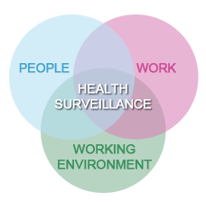
FC-EU-EHS-HEA-0801-1: Management of Vibration Exposure
2. Conducting HAVS training & Health surveillance
Training to consist of (but not limited to)
Legal Requirements
Theory of Vibration
Effects on Health
Determining Vibration Magnitude
Determining Vibration exposures
Control of Exposure
Health Surveillance
Health Surveillance – Why so important?
Prevention of Ill health
Improve workplace control measures
Detect Ill health at early stages to prevent deterioration
Required by law when exposed to noise and vibration
v1/Dec 2020

Slide 5
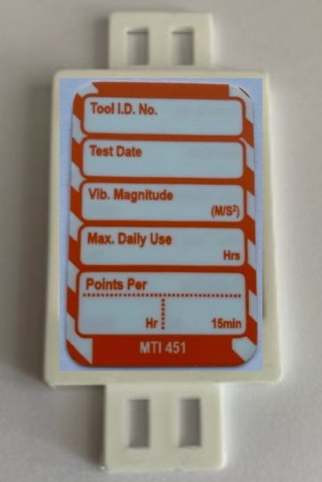
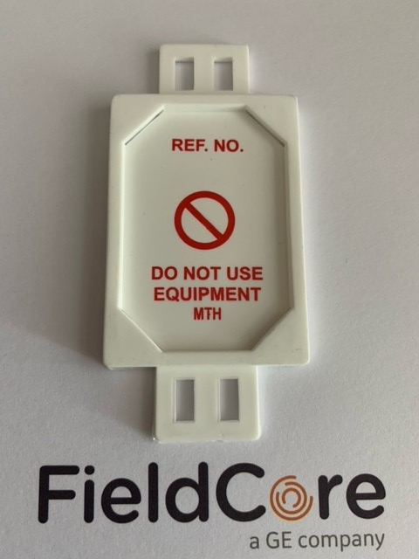
FC-EU-EHS-HEA-0801-1: Management of Vibration Exposure
3. How to read the tool tags
The orange tool tags will be attached to powered hand tools on the cable, where appropriate.
They will contain the following information:-
Tool ID Number
Vibration Magnitude
Max Daily Use
Points per Hour
Points per 15min
Note: The Test Date will not be applicable.
Tags will be held in a tag carrier.
1234
n/a
4.5
9:53
40
10
This information will need to be transferred to your individual Exposure Monitoring Log document or your Vibration Record Booklet.
v1/Dec 2020

Slide 6
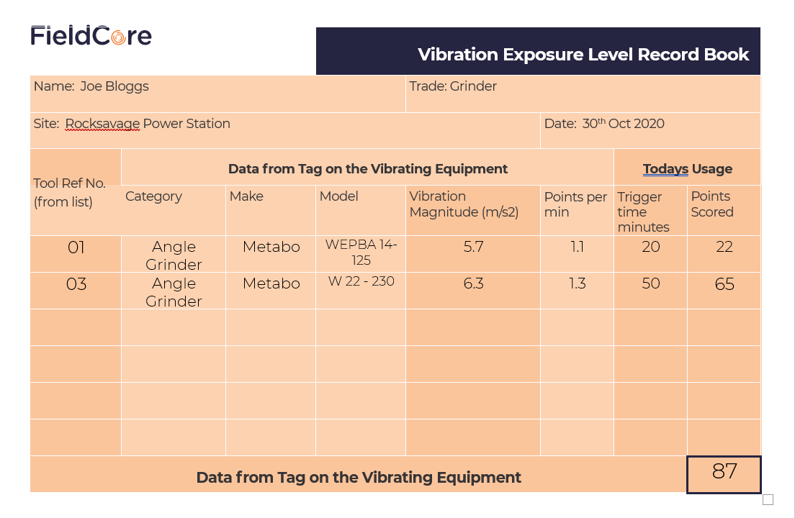
FC-EU-EHS-HEA-0801-1: Management of Vibration Exposure
4. How to fill in a Vibration Exposure level Record Book entry
Fill in personal details in the top section.
Multiply Points per minute by Trigger time and write in result in Points Scored.
Use the tool data in the book or on the tag to fill in data.
Add up all results to get Total Points for the day.
GREEN | GO | << 100pts | Below EAV. Aim to stay in this region
AMBER | BE AWARE | 100 - 399pts | EAV Exceeded. Reduce tool usage, share workload – Supervisor on alert.
RED | STOP | 400pts | ELV exceeded. STOP using handheld power tools.
v1/Dec 2020

Slide 7
FC-EU-EHS-HEA-0801-1: Management of Vibration Exposure
5. How to protect yourself from the risks associated with vibration
How can I help reduce the risks?
It is FieldCore’s responsibility to protect you against HAVS and carpal tunnel syndrome. It is essential that you apply the controls within your risk assessments to protect you against potential damage from vibrating tools. You should also help by asking if your job could be done in a different way without using vibrating tools and machines. If this cannot happen:
Ask to use suitable low vibration tools.
Always use the right tool for each job (quicker operation and less exposure to hand-arm vibration).
Check tools before using them to make sure they have been properly maintained and repaired to avoid increased vibration caused by faults or general wear.
Unauthorised modifications to equipment and ‘homemade’ adaptors or tools must not be used.
Make sure cutting tools are kept sharp so that they remain efficient.
Reduce the amount of time you use a tool in one go, by doing other jobs in between.
Avoid gripping or forcing a tool or work piece more than you have to.
Store tools so that they do not have very cold handles when next used.
Follow the Management of Vibration Procedure controls as outlined in the Vibration TRA: here
Monitor your vibration exposure using the Exposure Monitoring Log (or the HAVS Booklets if available).
When available to you, use the Reactec HAVwear digital monitoring equipment to track your personal vibration daily exposure.
Encourage good hand and finger /blood circulation by:
Keeping warm and dry (when necessary, wear gloves, hat, waterproofs and use heating pads if available)
Smoking reduces blood flow; giving up or cutting down on smoking further reduces risk from HAVS
Massaging and exercising your fingers during work breaks. (Rub them and wiggle the about during breaks)
What else can I do?
Learn to recognise the early signs and symptoms of HAVS.
Report any symptoms promptly to your line manager or the person who does your health checks.
STOP WORK and report abnormal levels of vibration from equipment to your supervisor.
Use any control measures has put in place to reduce the risk of HAVS.
Compete HAVS Health Surveillance questionnaires as required – be open and honest, it is for you best interest.
v1/Dec 2020

Slide 8
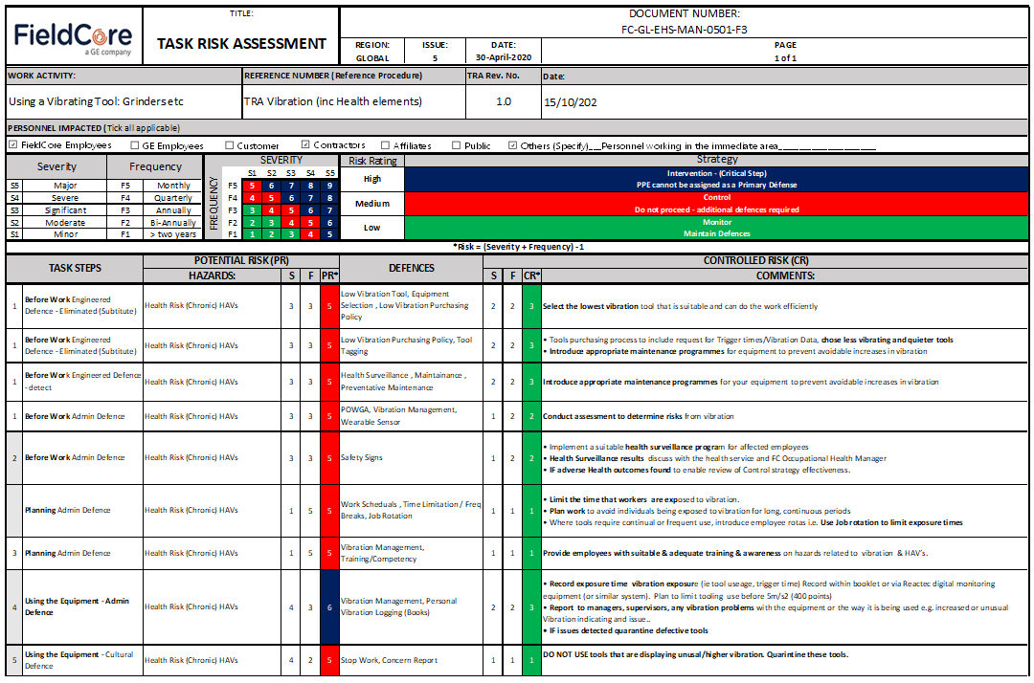
FC-EU-EHS-HEA-0801-1: Management of Vibration Exposure
6. Vibration Management, TRA UKTRA001 – Vibration here
Outage Managers must ensure that suitable POWRA/Task Risk Assessments are carried out and associated control measures implemented for all work, posing a significant risk to the health of workers.
v1/Dec 2020

Slide 9
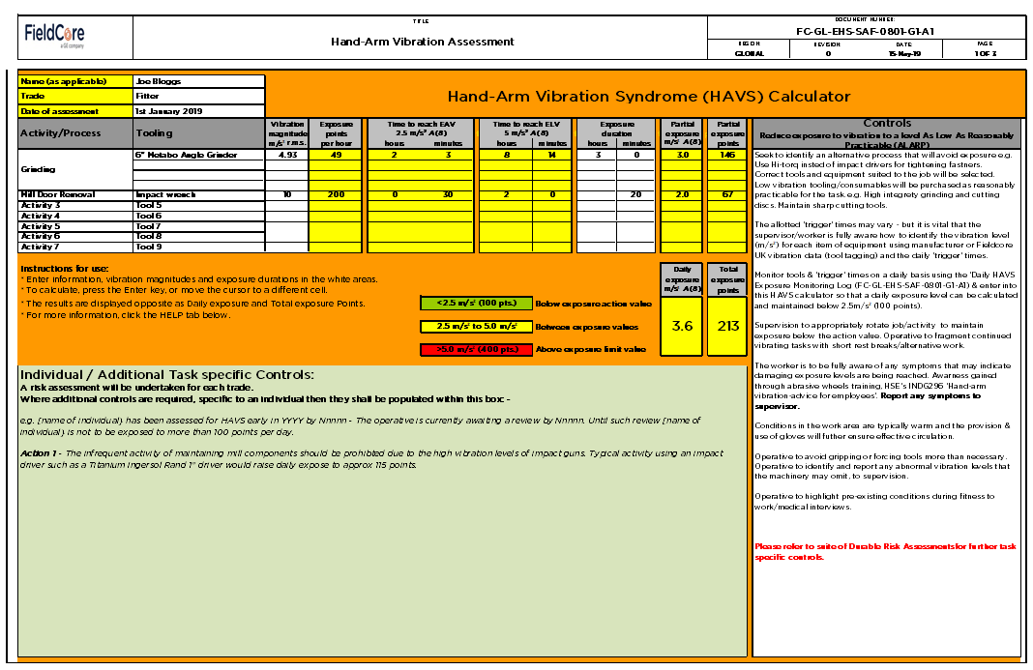
FC-EU-EHS-HEA-0801-1: Management of Vibration Exposure
7. Personal Hand-Arm Vibration Risk Assessment
  Risk Assessment:
  Need for Monitoring
  Employees must complete a point of use vibration risks assessment, using FC-GL-EHS-SAF-0801-G1-A1: Hand-Arm Vibration Assessment tool (and subsequently complete and retain trigger times etc within their “HAVS Booklet”).
v1/Dec 2020

Slide 10
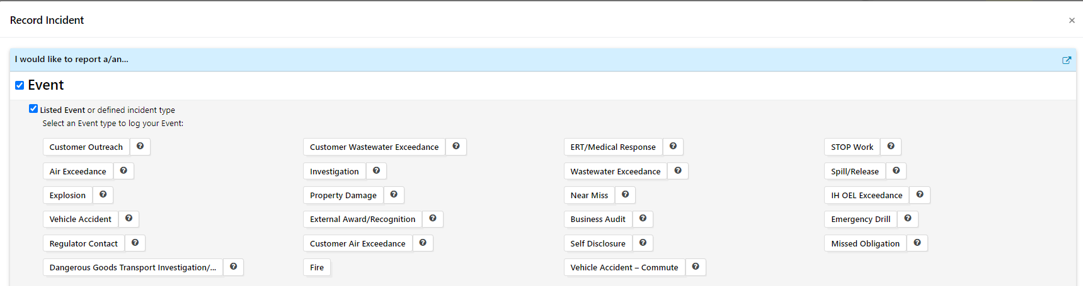
FC-EU-EHS-HEA-0801-1: Management of Vibration Exposure
8. Over Exposure Recording & Reporting using GenSuite
Use this section to record an over exposure to vibration when 400 points are reached.
Record the Event in Gensuite as below
v1/Oct 2020

